Slide 1


Spotify dataset analysis
Presented by Md Kamran Basit

Slide 2
Agenda
Project Overview
Analysis and Observations
Problems
Recommendations
Conclusion

Slide 3
Objective
The primary objective of this analysis is to conduct a comprehensive exploration of the Spotify Tracks dataset in order to uncover meaningful patterns, correlations, and insights related to various aspects of music data. This includes examining song characteristics such as tempo, energy, danceability, and acousticness; identifying trends that influence song popularity across different time periods and genres; and evaluating artist performance based on their musical attributes and audience engagement. By analyzing these factors in depth, the study aims to provide a better understanding of what contributes to a song’s success and how artists and listeners interact within the evolving landscape of the music industry.

Slide 4
Dataset analysis
Total Records: 62317 (With 22 attributes)
Each record represents a single track and includes:
• Track Information: Includes the track name, artist, album, release year, language, and track URL.
• Popularity Score: A numerical value representing how well the song is performing.
• Audio Features: Captures characteristics such as danceability, energy, valence, acousticness, instrumentalness, speechiness, tempo, loudness, liveness, and more.
• Musical Properties: Details the key, mode, and time signature of the track.

Slide 5
Univariate analysis
Popularity: measure oh how popular a track is ranging from 0 to 100
Tempo: estimated temp of a track in bpm
Duration : the duration of track
Danceability : measure of how a track is for dancing

Slide 6
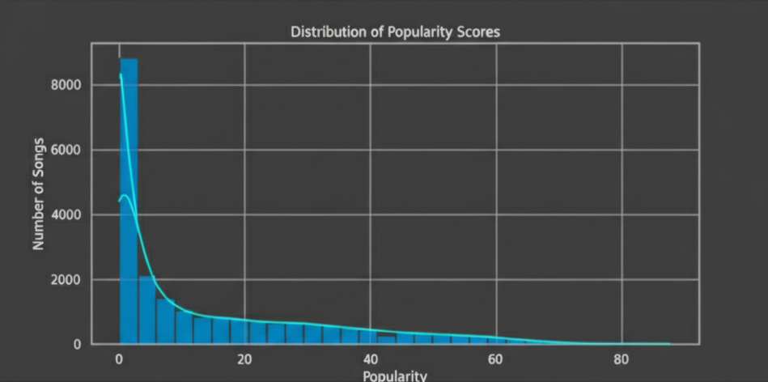
Popularity score
INSIGHT: most the songs have low to moderate popularity(0 to 50)

Slide 7
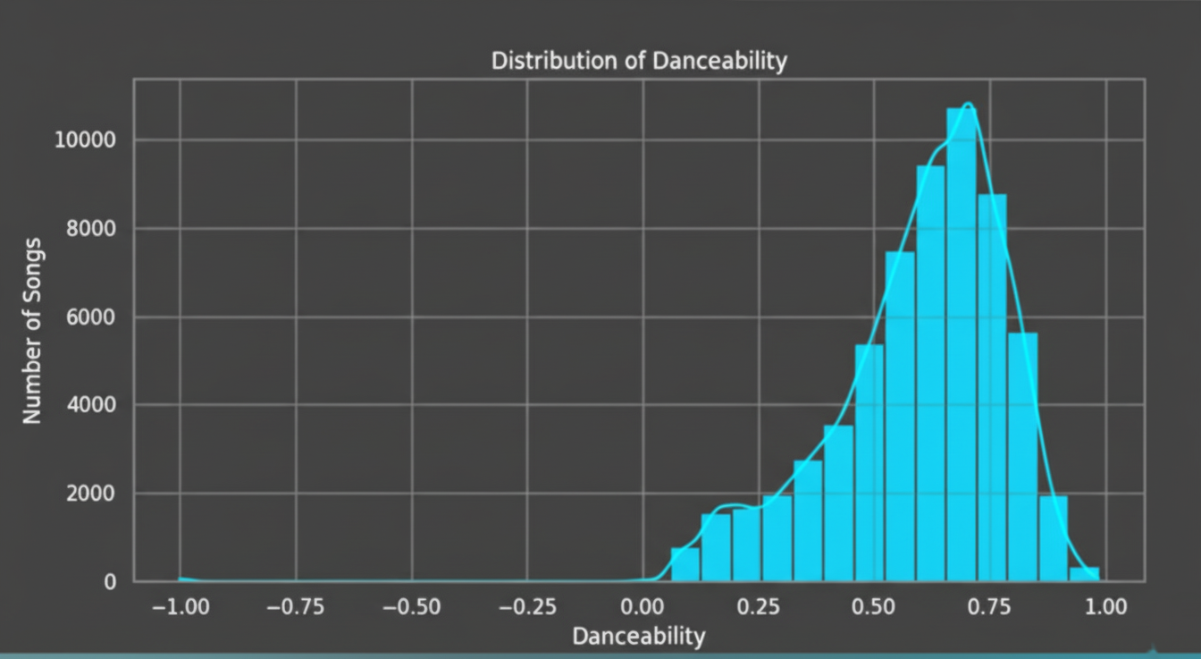
Making People Move (Danceability)
Insight: "Danceability is one of the strongest predictors of success. Songs with moderate-to-high danceability (scores of 0.6 and above) consistently achieve higher popularity, indicating a strong listener preference for tracks with a great groove."

Slide 8
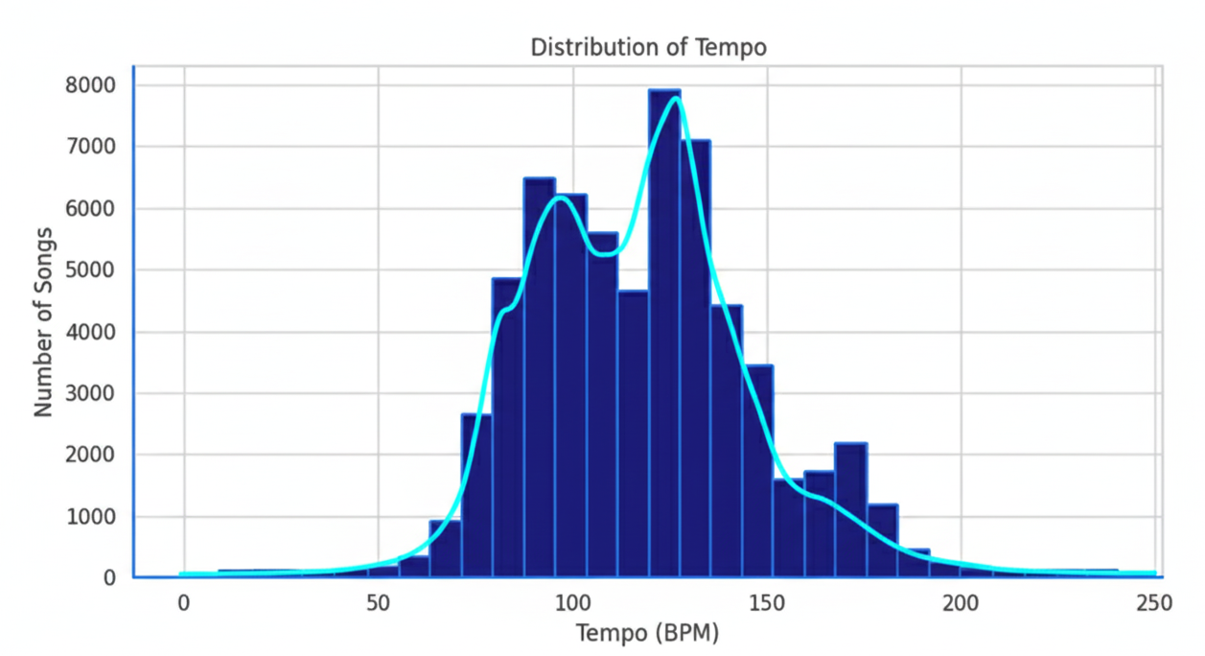
Distribution of tempo
The data indicates that a majority of song tempos fall within the 90-140 BPM range, peaking at approximately 120 BPM. To achieve commercial success, particularly in the pop or dance genres, it is advisable to target a tempo between 100-130 BPM. This specific range is effective as it corresponds to the natural rhythm of the human body and is conducive to dancing.

Slide 9
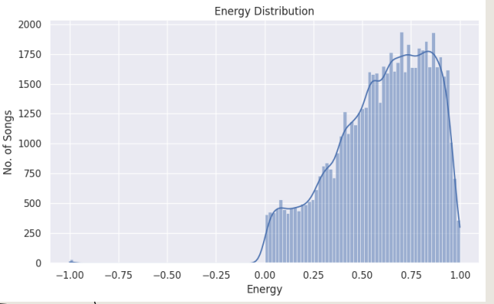
Energy distribution
The dataset is clearly dominated by high-intensity music. The energy levels for most songs cluster in the 0.5 to 0.8 range, which points to a collection rich with lively and upbeat tracks. In contrast, songs with very low energy—such as slow ballads or soft acoustic pieces—are far less frequent. The distribution also shows a slight right skew, indicating a small tail of exceptionally high-energy songs that likely represent popular dance or electronic hits.

Slide 10
⭐ Key Insights from the univariate Analysis
Popularity is heavily right–skewed, meaning only a small percentage of songs achieve high listener engagement.
Danceability is moderately high for most tracks, indicating that Spotify songs generally have a rhythmic, movement-friendly feel.
Energy levels are high in majority of tracks, showing preference toward powerful, intense, lively music. ✓ Valence (emotional positivity) mainly lies between 0 to 1, meaning listeners prefer happy songs rather than sad songs.
Tempo clusters around ~100–130 BPM, suggesting most tracks follow typical human preferred rhythm ranges.
Language distribution shows dominance of one main language, with others forming minor segments — indicating asymmetric linguistic representation.
Year-group distribution shows majority of tracks from modern eras (2010–2020), 16 suggesting dataset bias toward recent streaming-era content

Slide 11
Bivariate Analysis
What is Bivariate Analysis?
Bivariate analysis examines the relationship between two variables to understand how changes in one affect the other.
Why It Is Important?
Reveals patterns, correlations, and trends between two factors.
Helps identify which audio features may influence song popularity.
Allows comparison between two musical attributes to uncover meaningful interactions.
Supports deeper insights before moving to more complex multivariate analysis

Slide 12
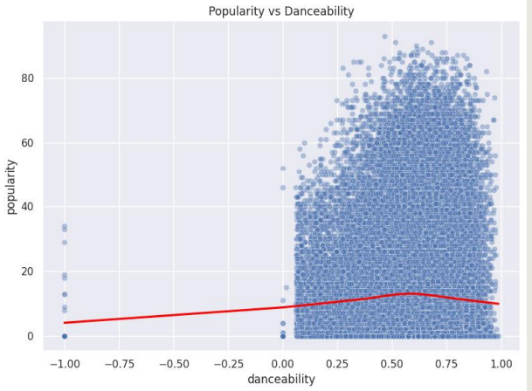
POPULARITY VS DANCEABILITY
Higher danceability is loosely associated with increased popularity, but the connection is not strong. Popularity varies greatly even for songs with similar danceability ratings, proving that being "danceable" is not a sole predictor of a hit. The success of some highly popular songs with lower danceability scores highlights the major impact of external factors like artist recognition and marketing.

Slide 13
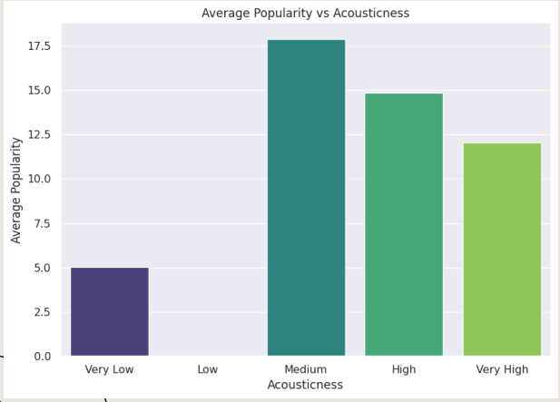
AVERAGE POPULARITY VS ACOUSTICNESS
The analysis of acousticness reveals a clear "sweet spot" in listener preference. On one end, heavily electronic or produced tracks (low acousticness) typically achieve a moderate level of popularity. On the opposite end, songs that are purely acoustic or "unplugged" (high acousticness) generally have the lowest popularity scores. The most successful songs, however, are those that strike a balance between acoustic instruments and electronic production, consistently achieving the highest popularity and suggesting this hybrid sound has the broadest appeal.

Slide 14
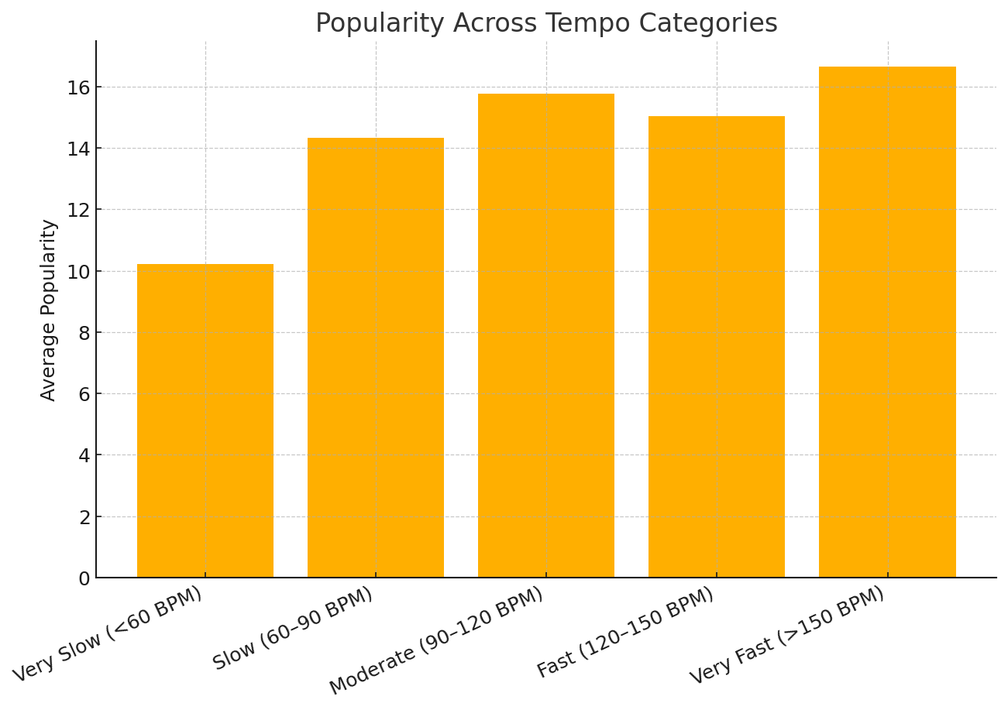
POPULARITY VS TEMPO
Popularity varies across different tempo groups, with no single tempo range dominating all others.
Moderate to fast tempos (90–150 BPM) generally show higher average popularity, reflecting common trends in pop and dance music.
Very slow and very fast songs show lower average popularity, suggesting listeners prefer mid-range tempos.
Overall, the analysis shows that tempo influences popularity, but it is not the only factor, as hits exist in every tempo category.

Slide 15
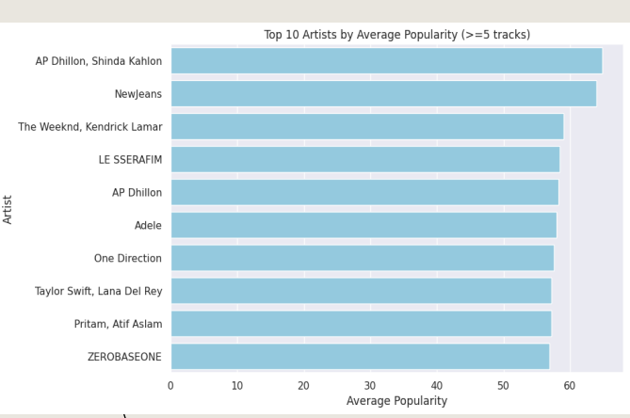
TOP ARTISTS BY AVG POPULARITY
The analysis shows that a select group of artists consistently achieves high average popularity across their catalog, a sign of their strong fanbase or significant mainstream appeal. To ensure the ranking reflects sustained success rather than just a single hit, only artists with five or more tracks were considered. A noticeable gap in performance often exists between the top-ranked artists and the rest, indicating that a few performers significantly outperform their peers in terms of audience reach.

Slide 16
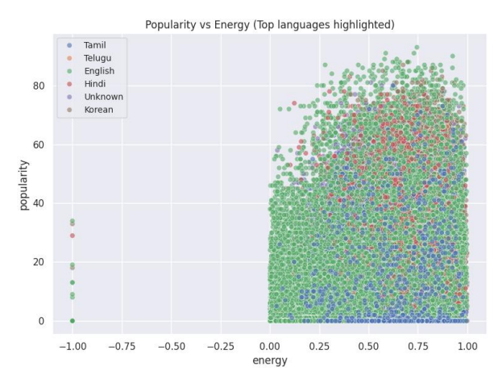
POPULARITY VS ENERGY (BY LANGUAGE)
Across most languages, there is a moderate positive trend suggesting that songs with higher energy levels are often slightly more popular, although this connection is not definitive. The data also reveals language-specific patterns, with languages like English and Spanish being more prevalent in the high-energy, high-popularity quadrant, indicating that hit songs are more common in these larger markets. However, popularity scores vary widely at all energy levels, which confirms that energy alone doesn't guarantee a song's success and that language likely plays a key role in its potential audience reach.

Slide 17
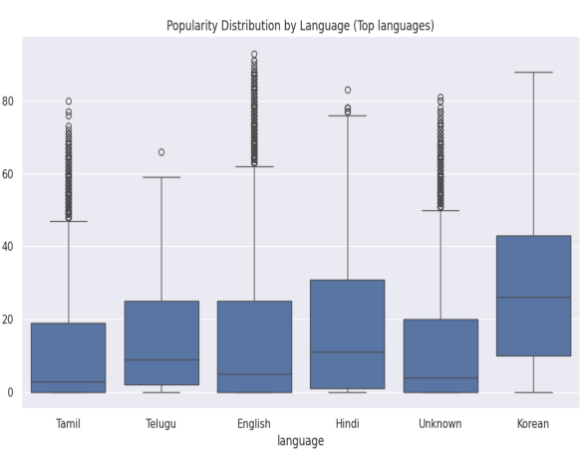
LANGUAGE VS POPULARITY (BOXPLOT)
The analysis shows that songs in English typically have a higher median popularity, which is likely a reflection of their broader global audience. However, success is not uniform within any language; there is significant variation in popularity, suggesting that a hit song can emerge in any language, even if the likelihoods differ. Furthermore, the existence of exceptionally popular non-English tracks demonstrates that a truly massive hit can transcend linguistic boundaries and defy general trends.

Slide 18
⭐ Key Insights from Bivariate Analysis
Popularity increases mildly with higher danceability, showing listeners prefer rhythmic and engaging songs.
Balanced acousticness leads to higher average popularity, while very high acousticness tends to reduce it.
Language affects popularity trends, with some languages performing consistently better due to global reach or cultural influence.
No single feature predicts popularity on its own — hits appear across all ranges of danceability, acousticness, tempo, and language.
Feature relationships reveal patterns, but popularity is ultimately shaped by a combination of musical attributes and external factors.
The analysis suggests that song success depends on multi-feature interaction, not isolated variables.

Slide 19
Multivariate Analysis
What is Multivariate Analysis?
Multivariate Analysis is a statistical technique used to analyze more than two variables at the same time to understand complex relationships, patterns, and interactions between them.
What I Included in the Multivariate Analysis
3D scatter plots combining three musical features at once.
Color-coded fourth variable (e.g., popularity or tempo) for deeper insight.
Tempo–Danceability–Energy relationship to observe rhythmic patterns.
Popularity–Duration–Tempo to check how length and speed affect success.
Popularity–Danceability–Energy to see how musical feel relates to hits.
Interaction patterns across multiple features, not visible in simple 2D graphs

Slide 20
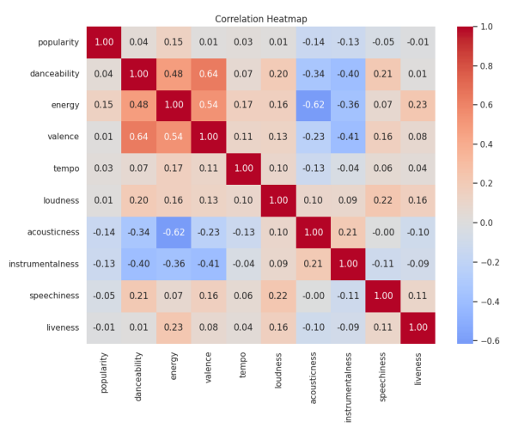
CORRELATION HEATMAP
The correlation heatmap reveals a strong positive relationship between energy, loudness, and danceability—meaning these features tend to increase together. Conversely, acousticness and instrumentalness show a negative correlation with those energetic qualities. It's also noteworthy that popularity has only a weak connection to any single audio feature, suggesting that a song's success is a complex result of many combined factors, not just one specific attribute.

Slide 21
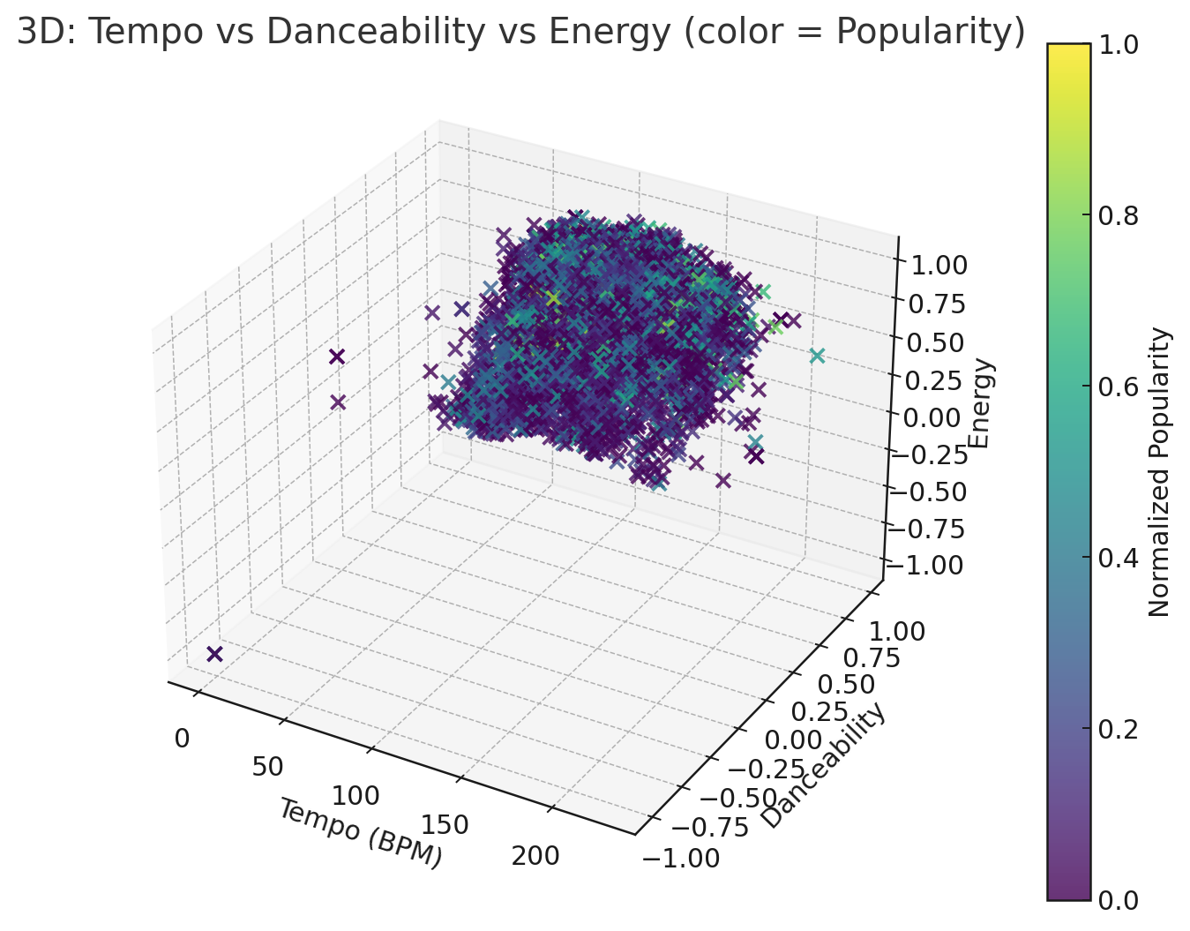
Tempo – Danceability-Energy- Popularity
• Songs with higher tempo generally show higher energy, highlighting a natural connection between musical speed and intensity. • Danceability rises along with energy, suggesting that energetic tracks tend to be more rhythmically engaging and easier to dance to. • Popularity (represented by color/size) is widely distributed across all combinations of tempo, danceability, and energy, showing that hit songs do not follow a single fixed musical formula. • This indicates that while tempo and energy shape a song’s feel, popularity depends on multiple factors beyond audio characteristics—such as artist influence, marketing, trends, and listener preferences.

Slide 22
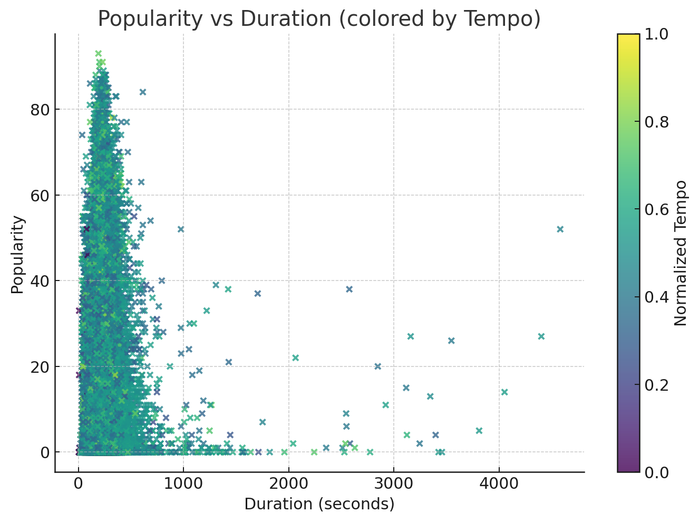
Popularity-duration-tempo
• Song popularity remains widely spread across all durations, showing that track length alone does not strongly determine whether a song becomes a hit. • Shorter and medium-length tracks (2–4 minutes) are densely populated, reflecting modern music trends where most commercially released songs fall within this range. • Tempo influences the distribution, as faster-tempo songs (shown in lighter/yellow shades) appear more frequently among tracks with moderate popularity, suggesting they may be more engaging or energetic for listeners. • However, popular songs exist across all tempo and duration combinations, indicating that success is shaped by a combination of factors—genre, artist recognition, production style, and listener preferences—not just tempo or length. • Overall, the graph highlights that duration and tempo contribute to the musical feel, but neither alone guarantees high popularity.

Slide 23
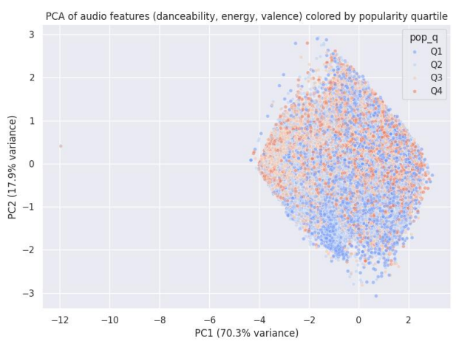
PCA SCATTER
The PCA plot shows that songs form distinct clusters along the primary axes (PC1 and PC2), revealing natural groupings based on combined audio characteristics like danceability, energy, and valence. However, these audio-based clusters do not neatly align with popularity levels; the popularity quartiles (Q1-Q4) are intermingled across the plot, which indicates that audio features alone do not determine a song's success. The first principal component (PC1) accounts for the majority of the variance, suggesting that a primary combination of features—likely energy and danceability—is the main differentiator between songs. PC2 then adds a secondary layer of detail, capturing nuances related to valence or other contrasting attributes.

Slide 24
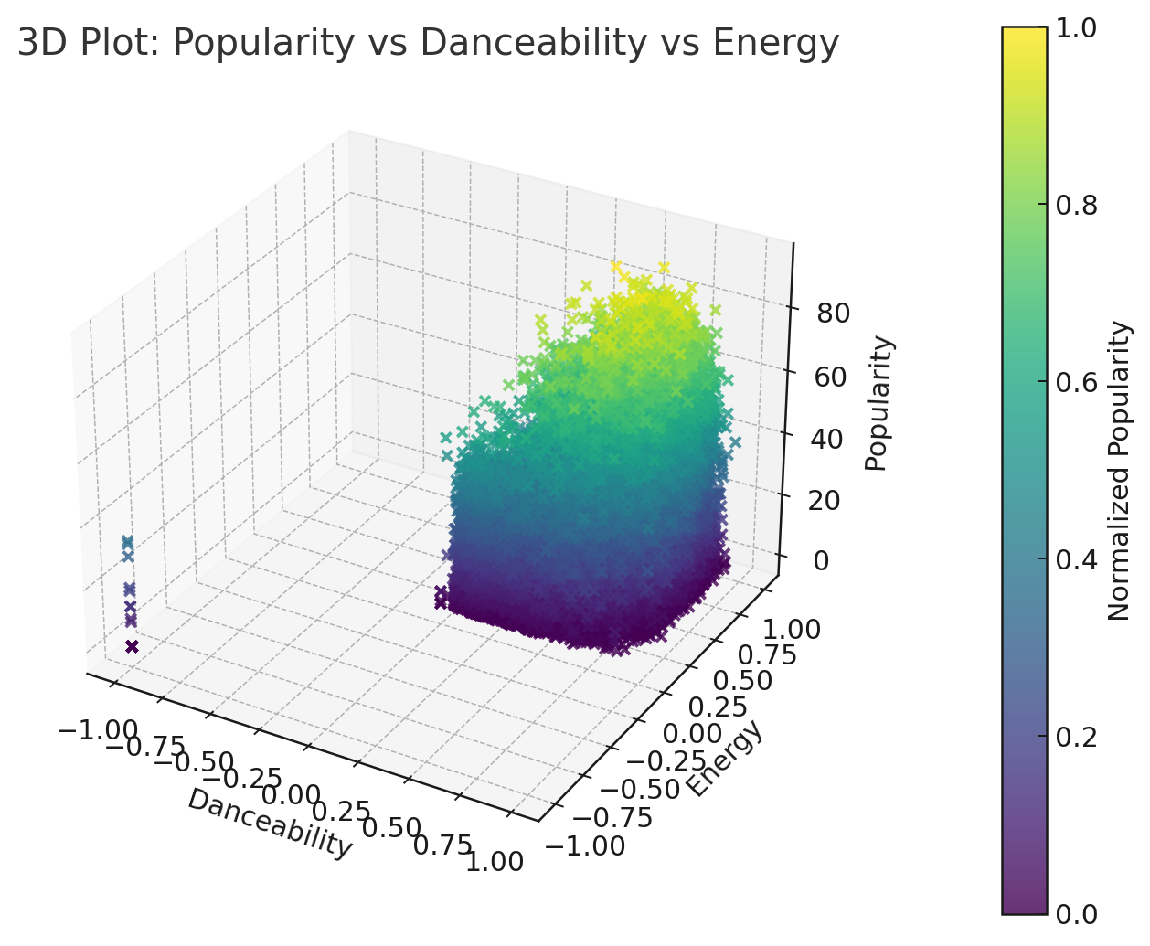
Popularity-danceability-energy
• Songs with higher danceability and higher energy tend to cluster toward higher popularity, showing that lively, rhythmic tracks often perform better. • However, popularity appears across all energy-danceability combinations, meaning no single audio pattern guarantees a hit. • Overall, the graph suggests that while energy and danceability contribute to popularity, they are not the only factors driving a song’s success.

Slide 25
⭐ Key Insights from the Multivariate Analysis
1. Popularity has no single dominant predictor
Even though energetic and danceable songs tend to score higher, popularity is widely scattered, showing that hits come in many styles.
2. Danceability and energy reinforce each other
Songs that are both highly energetic and highly danceable form a strong cluster—typical characteristics of modern pop and EDM tracks.
3. Tempo, duration, and energy show natural coupling
Faster and moderately long songs (2.5–4 minutes) often exhibit higher energy, aligning with listener preferences for dynamic, engaging tracks.
4. Popularity spreads across all combinations
Despite patterns, popular songs exist in all duration, tempo, danceability, and energy ranges, proving that audio features alone cannot fully explain a song’s commercial success.
5. Popularity depends on mixed feature interactions—not isolated variables
The 3D patterns reveal that rising popularity often results from a balance of tempo, energy, danceability, and overall production quality, not from extreme values.
6. Important real-world insight
External factors—such as artist fame, marketing, playlist placement, genre trends, and cultural context—play a major role beyond audio features.

Slide 26
Time series analysis
What is Time Series Analysis?
Time Series Analysis is the process of examining how a variable changes over time to identify trends, patterns, and long-term behavior.
Why It Is Useful in This Project
Helps understand how musical features evolve across years.
Reveals whether attributes like popularity, energy, tempo, danceability are increasing, decreasing, or stable.
Shows long-term industry trends in music production and listener preferences.
Helps compare past vs. present characteristics in the dataset

Slide 27
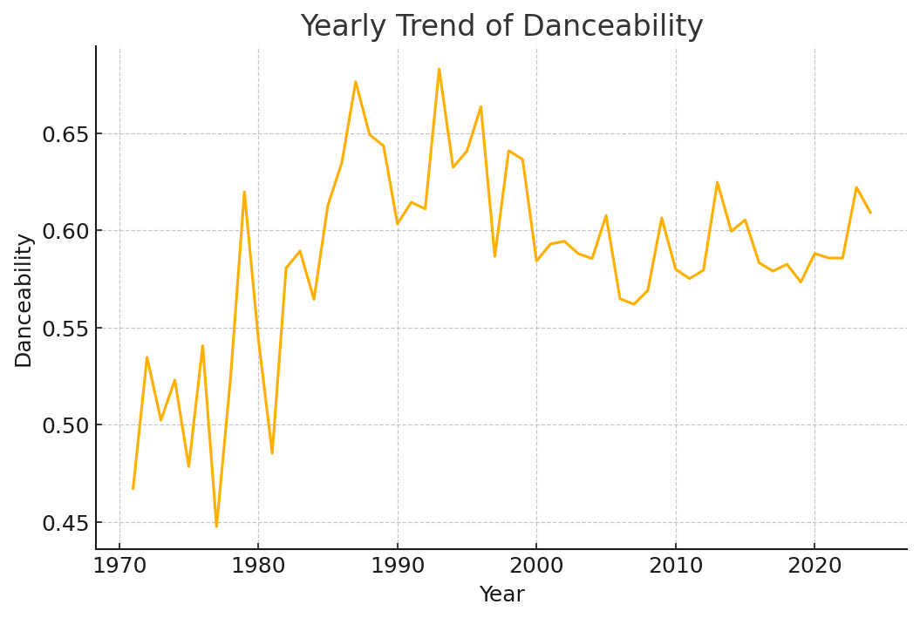
Danceability – Yearly Trend
Danceability remains consistent over time.
Only small changes across years.
Indicates steady preference for rhythmic, dance-friendly music.

Slide 28
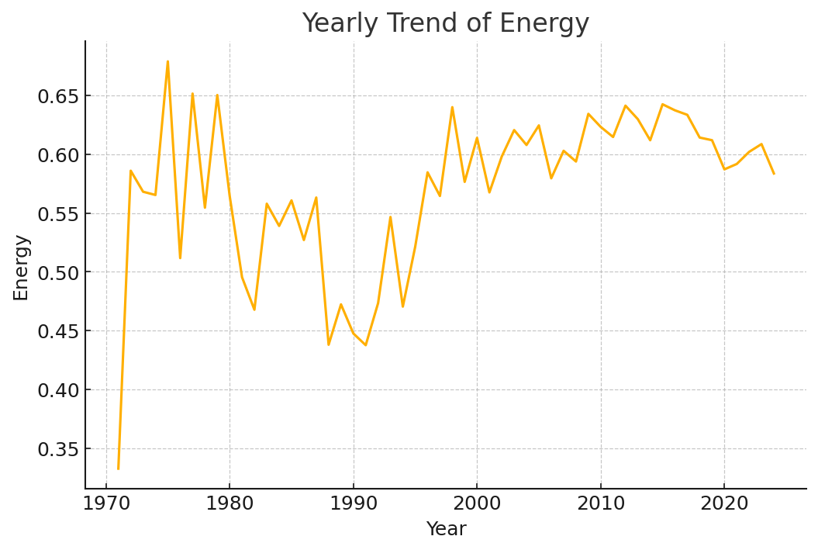
Energy – Yearly Trend
Energy levels show mild fluctuation, mostly stable.
Modern music stays consistently energetic.
No major shift toward softer or more intense sound.

Slide 29
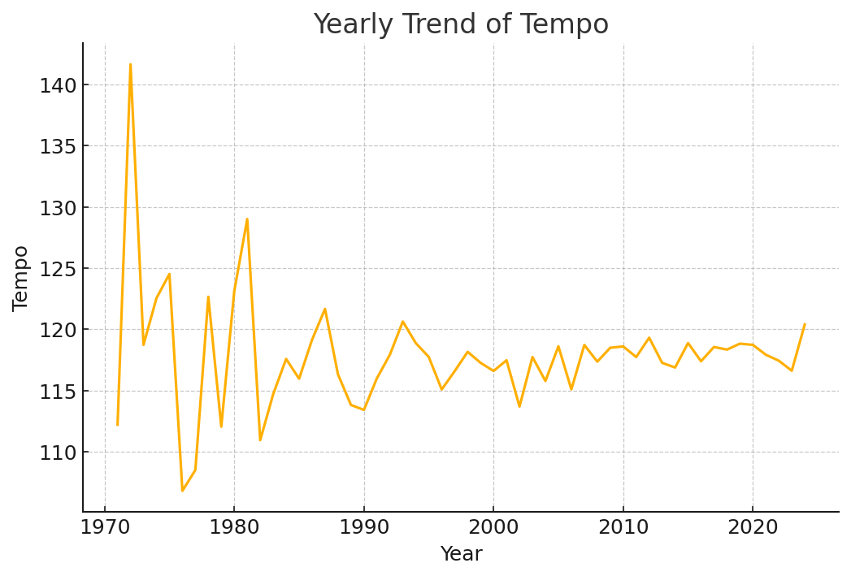
Tempo– Yearly Trend
Tempo stays within a similar BPM range each year.
No strong upward or downward trend.
Reflects stable listener preference for familiar tempos.

Slide 30
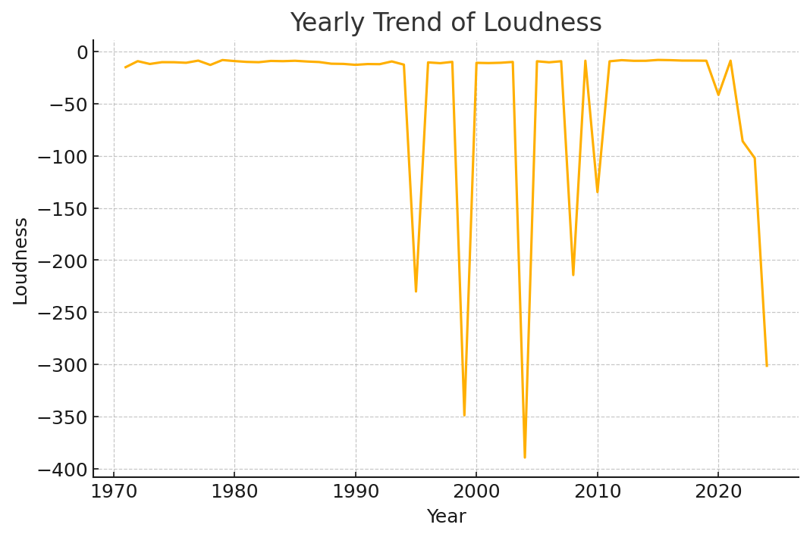
Loudness– Yearly Trend
Loudness levels show slight variation, mostly stable.
Reflects consistent mastering practices.
No major increase or decrease in loudness over time.

Slide 31
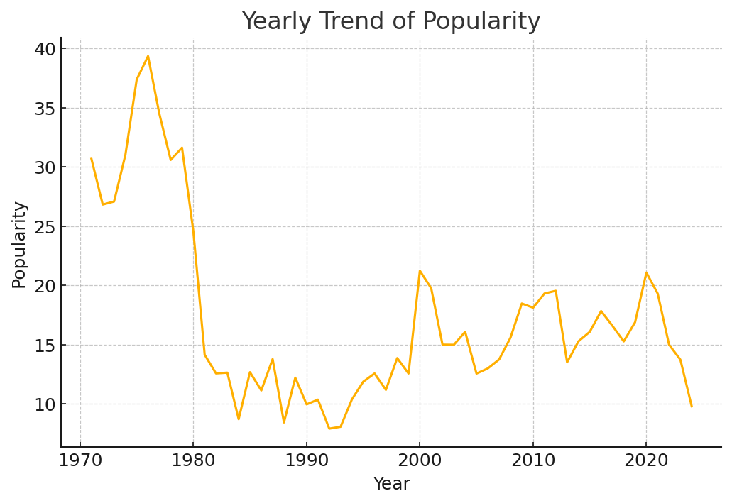
Popularity – Yearly Trend
Average popularity stays fairly stable over years.
No major long-term rise or fall.
Popularity varies year to year due to trends & listener behavior.

Slide 32
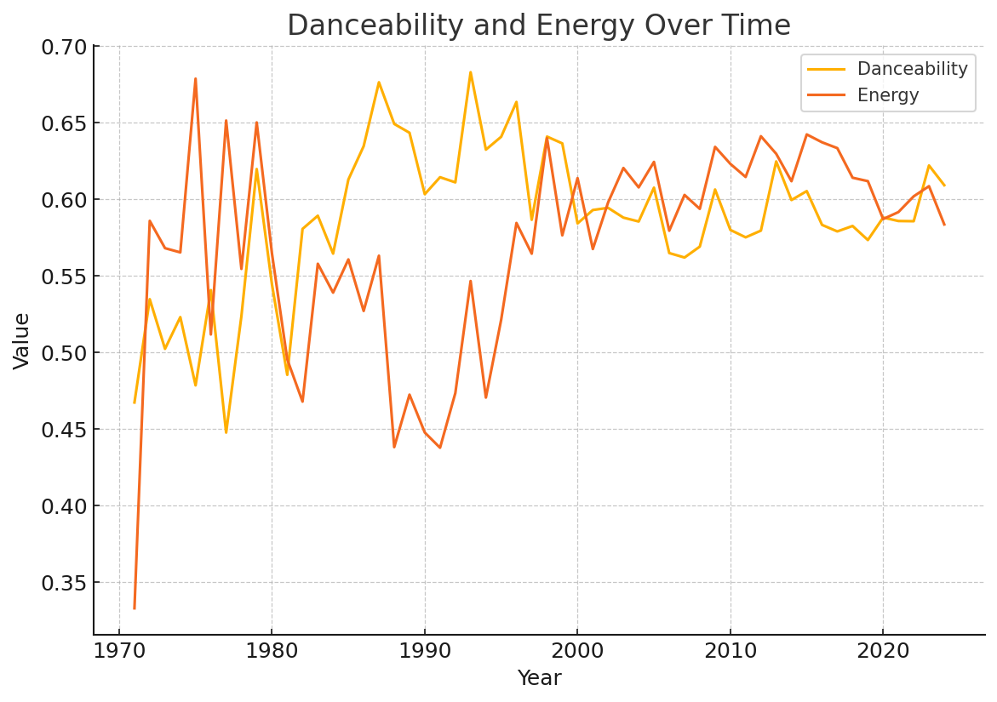
Danceability vs energy
Both danceability and energy remain fairly stable across the years, with only small fluctuations.
Danceability shows a slightly steadier pattern, indicating consistent rhythmic characteristics in music over time.
Energy also stays within a similar range, meaning the intensity of songs has not changed drastically.
There are no major upward or downward trends, suggesting that core musical features have remained consistent across the years.
Minor variations reflect shifts in musical styles, but not enough to indicate a long-term change.
Overall, the graph shows that modern music maintains a balanced mix of rhythm (danceability) and intensity (energy) over time.

Slide 33
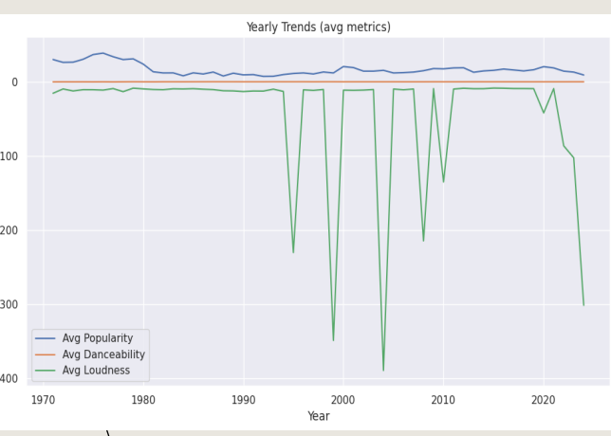
YEARLY TRENDS
Analyzing these audio features over time reveals several key evolutions in music. Average song popularity fluctuates annually, which likely mirrors shifts in mainstream musical tastes and listener preferences. Similarly, the average danceability of songs shows gradual changes, pointing to an evolution in production styles where tracks become more or less rhythm-focused. Finally, trends in average loudness can be observed, with historical increases or decreases possibly reflecting broader industry practices such as the "loudness war" or new approaches to audio mastering.

Slide 34
⭐ Key Insights from Time Series Analysis
The overall musical features — popularity, danceability, energy, tempo, and loudness — remain fairly stable across the years, showing no drastic long-term shifts.
Popularity fluctuates year to year, suggesting that hit songs depend more on trends, marketing, and cultural moments rather than time-based patterns in audio features.
Danceability and energy maintain steady levels, indicating that modern music consistently favors rhythmic, energetic production styles.
Tempo stays within a similar BPM range over time, showing that listener preferences for song speed remain relatively unchanged.
Loudness varies slightly, reflecting mastering and production trends, but shows no extreme shifts in recent years.
Overall, the time series reveals that while the music industry evolves, the core audio characteristics of mainstream tracks remain surprisingly consistent over time.

Slide 35
CONCLUSION
Popularity Distribution: The majority of tracks have moderate popularity (scores between 20–50), while only a select few achieve global hit status with scores of 80 or higher.
Danceability: Spotify’s catalog leans heavily toward upbeat and rhythm-driven music, with the majority of songs being moderately to highly danceable (0.5–0.8).
Energy Levels: High-energy songs dominate the dataset. There are very few calm or low-energy tracks, showing a clear listener preference for lively music.
Feature Correlations: Energy, loudness, and danceability are positively correlated. In contrast, acousticness and instrumentalness are negatively correlated with these attributes. Popularity itself has only a weak link to any single feature, indicating that multiple factors influence a hit.

Slide 36
Language Impact: English-language tracks generally show higher popularity due to a wider global audience, but exceptional hits can and do emerge in all languages.
Artist Performance: A few top artists consistently maintain higher average popularity, showing that sustained success depends on consistent audience engagement, not just one-time hits.
Yearly Trends: Key musical attributes like popularity, danceability, and loudness evolve over the years, reflecting ongoing changes in listener preferences and music production styles.
Acousticness "Sweet Spot": Songs with moderate acousticness—a blend of acoustic and electronic elements—tend to be the most popular, outperforming tracks that are either purely acoustic or overly electronic.
Overall Observation: A song's popularity depends on a balanced combination of features rather than extremes. Overall, Spotify listeners prefer energetic, danceable, and emotionally positive music.

